Slide 1
Java SE 17 – Presentation
Chapter 14 - IO

Slide 2
Chapter 14 - IO
NIO stands for ... (people usually call it ...). In the exam, we will talk about ..., there is also a ... version which covers ... (but we don't talk about it here)
Referencing Files and Directories
- We start this chapter by reviewing what is ... and ... in file .... We will also introduce ... class and ... interface along with how to create ...
Conceptualizing the File System
- We start with basic topic first. Data is stored in long term ... such as ..., ..., ...
– A ... stores data. ... is organized in a hierarchial structure called ...
- Directory is ... store ... and other ... too. When working with ..., we usually consider it as .... As a matter of fact, we use many same .../... to work with .../... (for example, renaming .../... can be done with the same ... in Java) (note: ... will refer to both .../...)
- To interact with files, we need to connect to .... The ... will responsible for .../... on our computer. Different OS will have different ... (for example, Windows ... Unix ...). In the exam, we just need to know how to use ... Java and JVM will ... OS ... allowing us to ... same ... on different ...
- Root ... is ... (Windows is ... Linux-based is ...0
- Path is ... of a ... in ... Each ... system use different ... (Windows is ... while Linux use ...). The left is ... the right is ... (for example, /user/home/zoo.txt reside in ...)

Slide 3
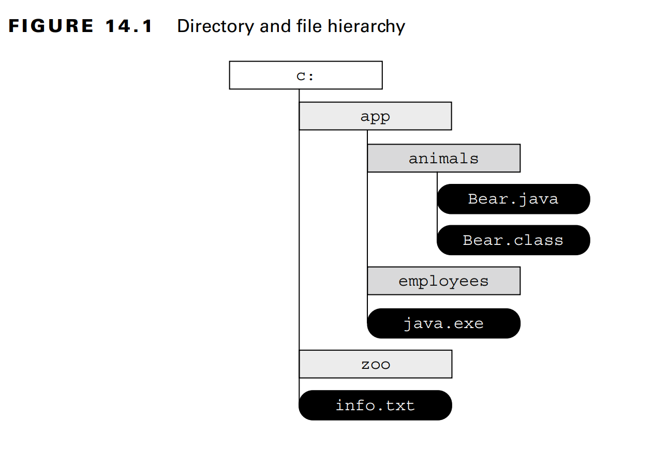
Chapter 14 - IO
Operating System File Separators
- Different OS has ... for ... name (For example, with Windows uses ... while Linux uses ...). Despite that, many ... language supports ... when talking about ... name. In Java, it supports a ... property to ...
(code illustration snippet 1)

Slide 4
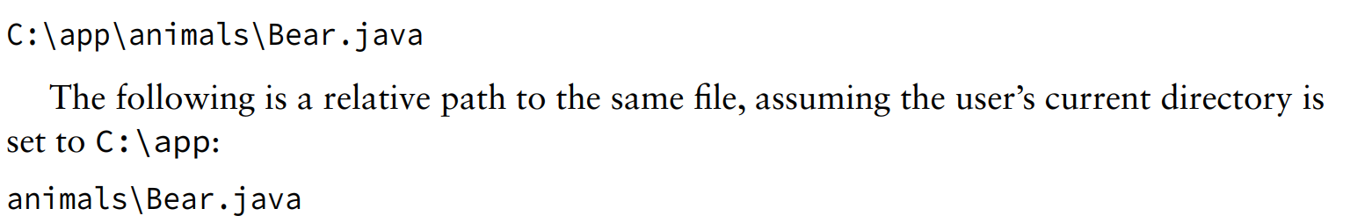
Chapter 14 - IO
- We use both ... and ... path to refer to .../... in the ... system.
- ... path is ...
- ... path is ...

Slide 5
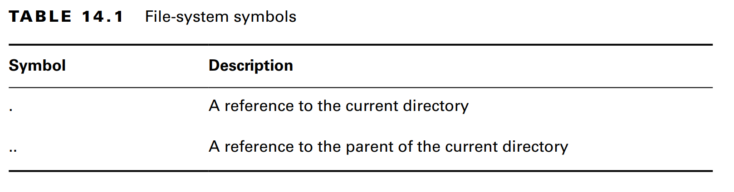
Chapter 14 - IO
- Determining whether this is ... or ... path depends on the .... For the exam, we will use the following convention
+) "/" => ...
+) "C:\" => ..
+) "bird/zoo.txt" => ...
- ... and ... path also contain something called ...
– Path symbol is a ... characters that has special ... in ... system ... For the exam, there are 2 types we need to know

Slide 6
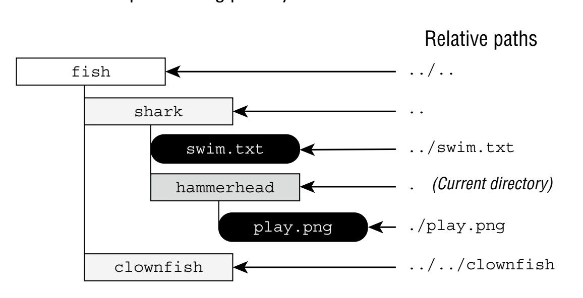
Chapter 14 - IO
- Sometime, we will encounter redundant ... (such as ﻿/fish/clownfish/../shark/./swim.txt, which can be ... as swim.txt). We will learn how to ... this in the chapter

Slide 7
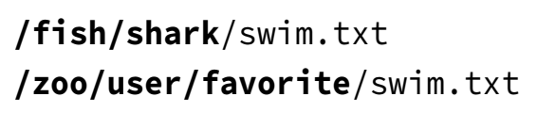
Chapter 14 - IO
(Note: ".." will ...)
- Symbolic link is a special ... in ... system ... pointer to ... (favorite is symbolic link and shark is the original)

Slide 8
Chapter 14 - IO
- Elements in ... can be ... directly or through the ...
- In general, ... pretty easy to understand ... because OS has handled .... While I/O ... not ..., NIO.2 fully ... from .../.../... symbolic link in ... system
Creating a File or Path
- To do something useful, we need ... to represent .../... in the ... system. By using the legacy ... class or NIO.2 with ... interface. The ... class and ... interface cant modify ... although they are passed in as ... file ...
- Remember that a ... is also a ...
Creating a File
- There are 3 different ...
(code illustration snippet 2)
- All 3 constructors create the same ... with the same ... in ... system. If we pass null in the ...=> Then it will be ... and treated as a ... constructor..
Creating a Path
- Since ... is an Interface => ... instance immediately (after all, interface ...). Java provides some .../... used to get the ... instance. The easiest way to do this is to use ... from ... interface or ... from ... class
(code illustration snippet 3)

Slide 9
Chapter 14 - IO
- Both methods allow varargs to ... element. Then, it will be ... together with ... character from OS
- We also have a ... class called ...
- We can see in the example is that we use ... method from ... and ... method from ... (we will use both ... in the chapter)
- We can see that both I/O and NIO.2 can interact with something called ... (...). This is a String used to identify .... It starts with a ... used to identify the type of ..., followed by a path ... like file:// for ... and ...,...,... for remote ...
Switiching between File and Path
- Because both .../... reference to a position on ..., it will be very useful if we can ... between each other ... => Java support this very ... by ...
(code illustration snippet 4)
- Many old ... depends on the ... class => This makes it easier to get ... from ... and vice versa.
- When working with new ..., we should use the newer ... interface because it has more ... and also ... FileSystem
Obtaining a Path from the FileSystems Class
- NIO.2 use a lot of ... method to ... objects. ... class creates instances of ... class. The ... class has methods to work directly with ... system. Both ... method from ... and ... method from ... are the shortcuts for the methods in ... class
(code illustration snippet 5)

Slide 10
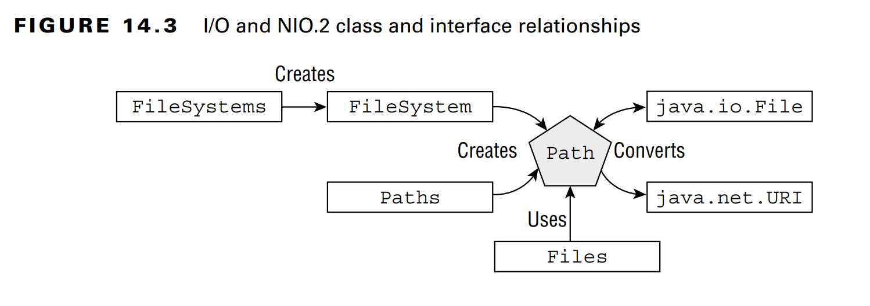
Chapter 14 - IO
Reviewing IO and NIO.2 relationships
- The model of ... library is much smaller and we just need to understand the ... class. On the other hand, NIO.2 has more ... and uses a lot of ... method. Many interactions in the ... library are related to .../... and .../factory class

Slide 11
Chapter 14 - IO
- An easy way to remember this is that ... plural ... singular ...
– ... is an IO class while ... is a helper class (... works with ... interface, not with ... instance). These 2 APIs are completely different
- Remember that ... method works with ... and ... method must have ...

Slide 12
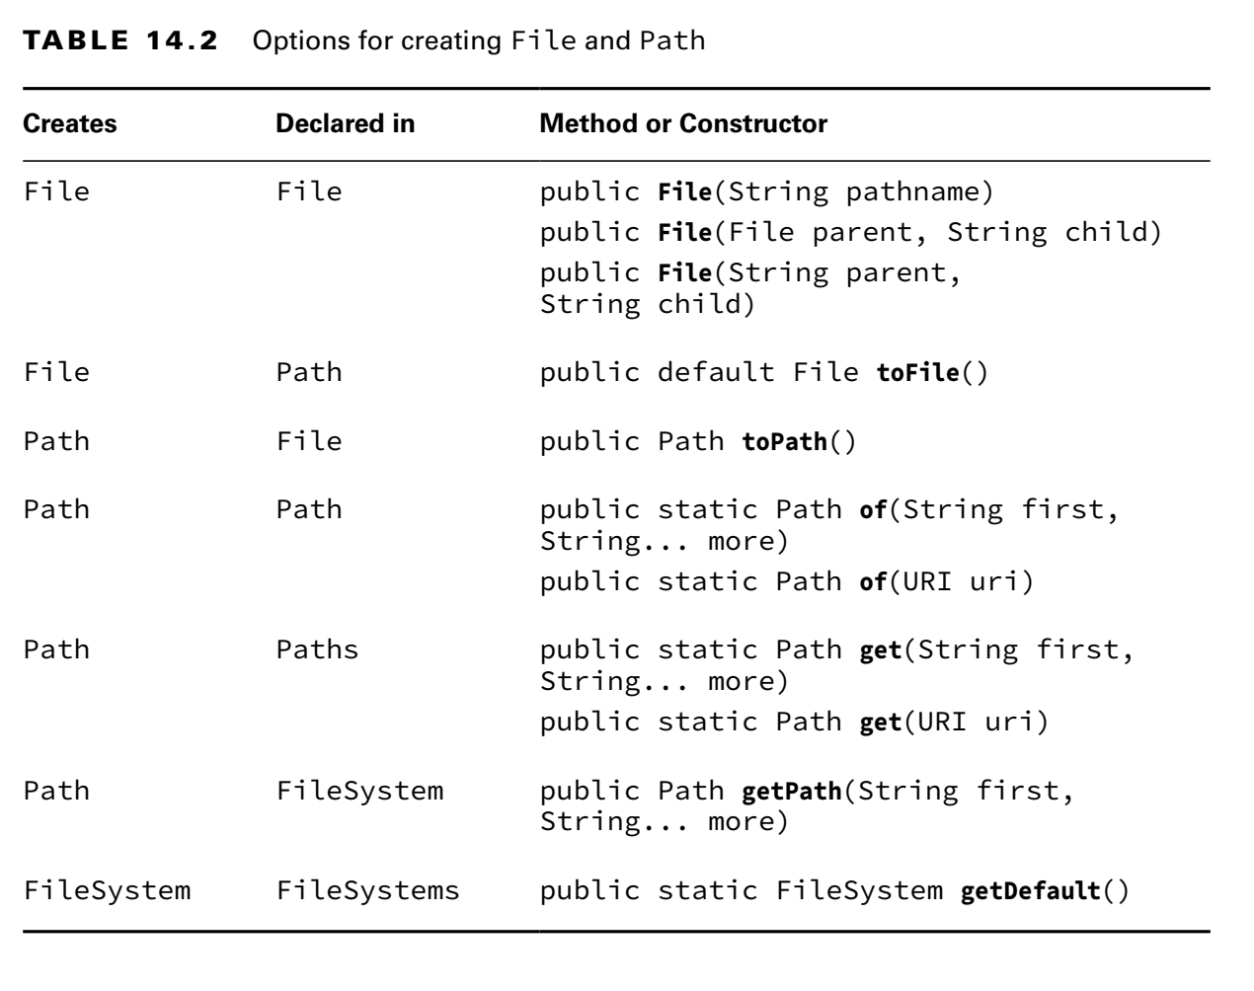
Chapter 14 - IO

Slide 13
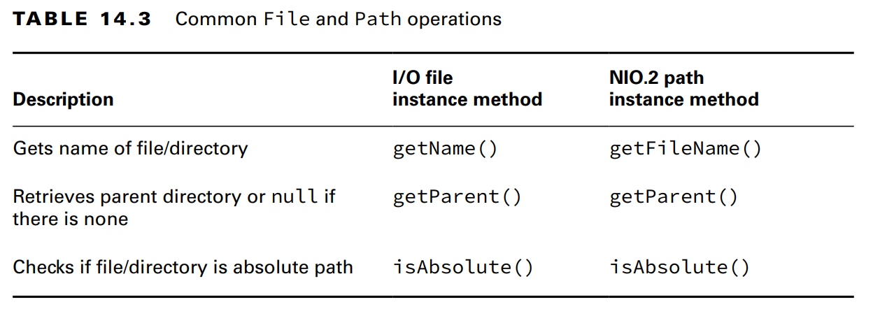
Chapter 14 - IO
Operating on File and Path
- Now we know how to create ... and .., now we will learn how ...
Using shared functionality
- There are many operations ... both ... and ... library

Slide 14
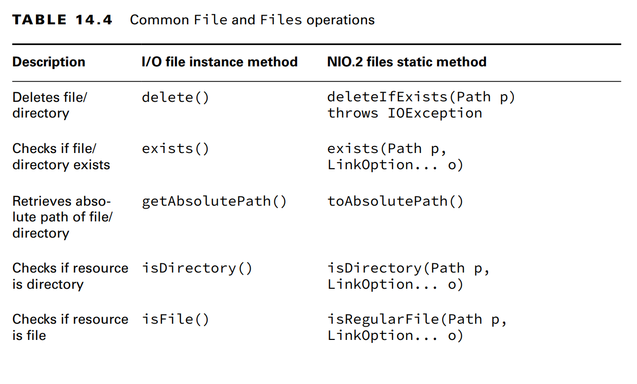
Chapter 14 - IO

Slide 15
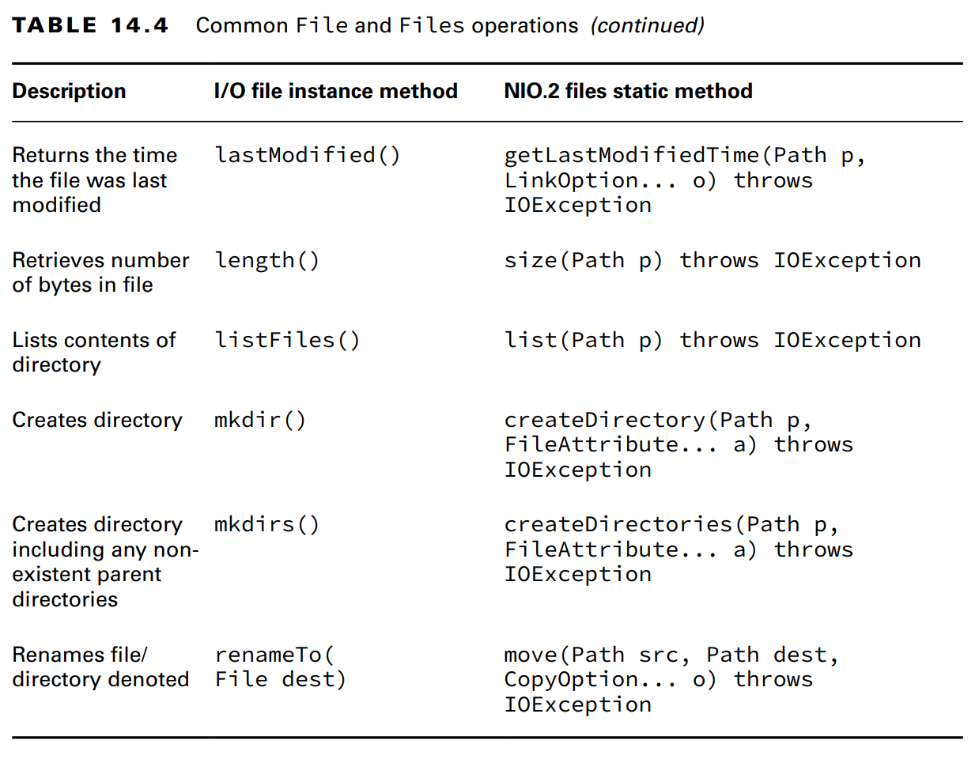
Chapter 14 - IO

Slide 16
Chapter 14 - IO
(code illustration snippet 6)
- On Windows, the ... system use "\" for ... so in Java we have to use "\\" because of ... But Java ... will read this as "\"
- Now, we will rewrite ...
(code illustration snippet 7)
Closing the Stream
- We can see that our previous example, we put the ... object in try .... NIO.2 ...-based method will open a ... to the ... system and this connection must be ... or else a ... event might happen.
- Resource leak in ... system means other ... can't ... until ....
- If we assume that the ... operation on the ... will close the ... then we are making a mistake. There are many debates around this and the side who supports mannual ... won
– On the bright side, only Stream that ... will need to be, all Stream that we ...
- Finally, exams will never close ... properly, we just need to know to put ... in the try ...
Handling methods that declare IOException
- There are many methods in this chapter ..., here are some of the common
+) Loss of ... to the ... system +) ... exists but can't be....
+) .../... exists but ... +) .../... required but not ...

Slide 17
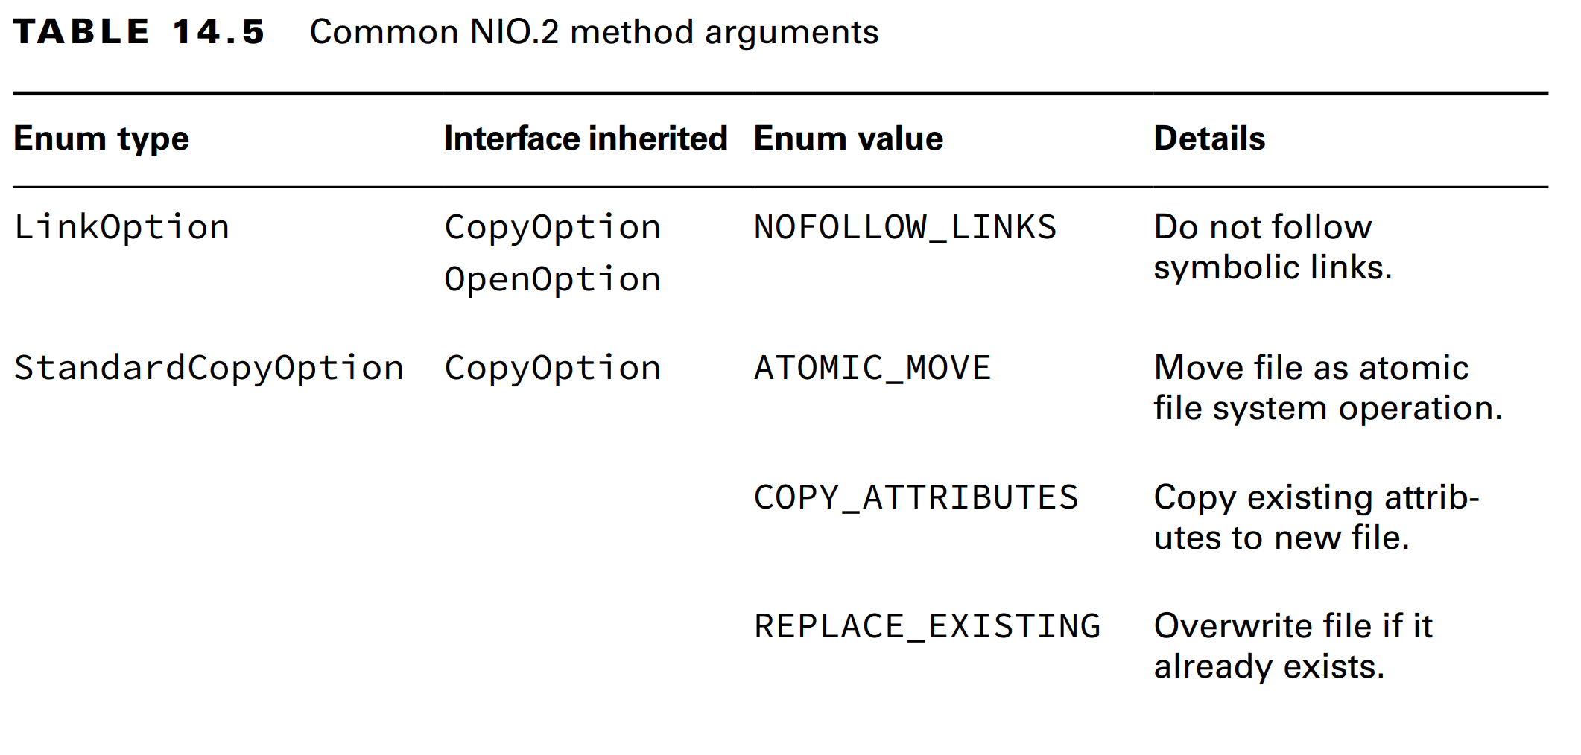
Chapter 14 - IO
- All methods that .../... the .../... in the ... class usually throws. But there are exceptions to this case (for example, method ...() doesn't throws be cause if it throws ...)
– Just remember that if a method throws ..., it means that the ... must be ...
Providing NIO.2 optional Parameters
- Many methods in NIO.2 has varargs to ...

Slide 18
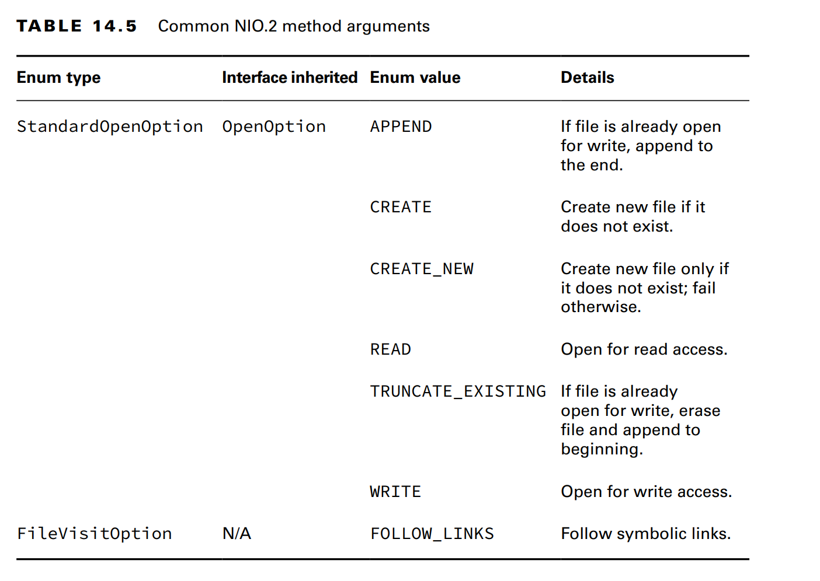
Chapter 14 - IO

Slide 19
Chapter 14 - IO
- Except the ...() and ...() methods, we won't discuss about the ... when introducing new ...
(code illustration snippet 8)
- If we don't use ... enum => if the path is the ... => ..., if the path is the ... => ...
– If we use ... enum => it will check whether ...
– Notice that there are some ... that implement ... => It means that some methods can be used with multiple ... (for example, the method move() accept 1 CopyOption ... => we can use multiple ...)
(code illustration snippet 9)
Interacting with NIO.2 Path
- Just like String, Path is ... => the following example shows lost ... because ...
(code illustration snippet 10)
- Methods in the ... interface will mutate the ... in some way and return a ... => allowing to be ...
(code illustration snippet 11)
Viewing the Path
- ... interface has 3 methods
+) ... is used to return a String .... In fact, it is the only method in the ... to return a String, other will return ...
+) ... used to return a ... +) ... used to return ... using index ...

Slide 20
Chapter 14 - IO
(code illustration snippet 12)
- Although using ... path, the ... directory is not ... in the list ...
(code illustration snippet 13)
- The output of ... depends ...
Creating Part of the Path
- The ... interface also include a method ... used to create a part of .... It has 2 parameters, 1 is ... and 1 is ... (sounds like ...)
(code illustration snippet 14)
- If we have invalid (even if ... same) ... => ...
(code illustration snippet 15)
Accessing Path elements
- ... interface includes a lot of method to get ... part of the ... and return a ...
getFileName()
getParent() will return the full ... (null if ... highest or ...)
getRoot()
(code illustration snippet 15)
- We can see that the first and third examples passed in a ... and the method didnt ... further away ...

Slide 21
Chapter 14 - IO
- We can see that this method didnt handle ... and consider it as a part .... While most of the methods in ... will consider ..., some of the method we ... will clean ...
Resolving Path
- Assume that we want to concatenate ... just like how we do it with ... We have the method ..., the overloaded version allows us to ... or ...
- Objects that invokes ... will merge with ...
(code illustration snippet 17)
- What if the argument is a ...
(code illustration snippet 18)
- It is very simple, if both ... are ... path => only ... is returned because ... can't ...
– On the exam, just think ... is like String ... (although this method serves for a better purpose)
Relativizing a Path
- Path interface also include a method called ... to build a ... from a path to other path ... (it will use path ...)
(code illustration snippet 19)

Slide 22
Chapter 14 - IO
- This is the idea, if we have a path in ... system and we have another ..., how much step do we need to ... (for example, from fish.txt to friendly.txt, we need ... steps to ...) (I found this way quite stupid and the most formal way to describe this method is that it will create a ... so that when A.resolve(..) = ... where A,..,... is ...)
- If both paths are ..., then ... will consider both ... are in the same ...
(code illustration snippet 20)
- The ... method requires that both ... must be ... or ... or else ...
(code illustration snippet 21)
- If we are using Windows, then another requirement is ...
(code illustration snippet 22)
Normalizing a Path
- Up until now, we have many examples that have redundant .... Luckily, Java provides a method called ... to remove the ... According to its official definition, any occurence of ... will be .... Moreover, any occurence of ... followed by a non ... will also be considered as ... => this method will ... until it can't ...
– This method also warns the user that the final ... might lead to another ...
(code illustration snippet 23)
- However, ... will only remove ... not all
– ... also help us in comparing ... (code illustration snippet 24)

Slide 23
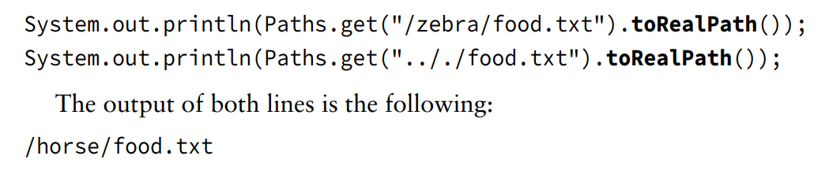
Chapter 14 - IO
Retrieving the real File System Path
- When working with ... in theory, it might looks useful. However, we might actually want to confirm whether the ... is exist or not ... in the ... system
– If we want to do this, we need to use ...
- This method is a combination of ... and ...
- But unlike the ... it will throw ... if ... and also resolve ... if the argument is a ...
(code illustration snippet 25)

Slide 24
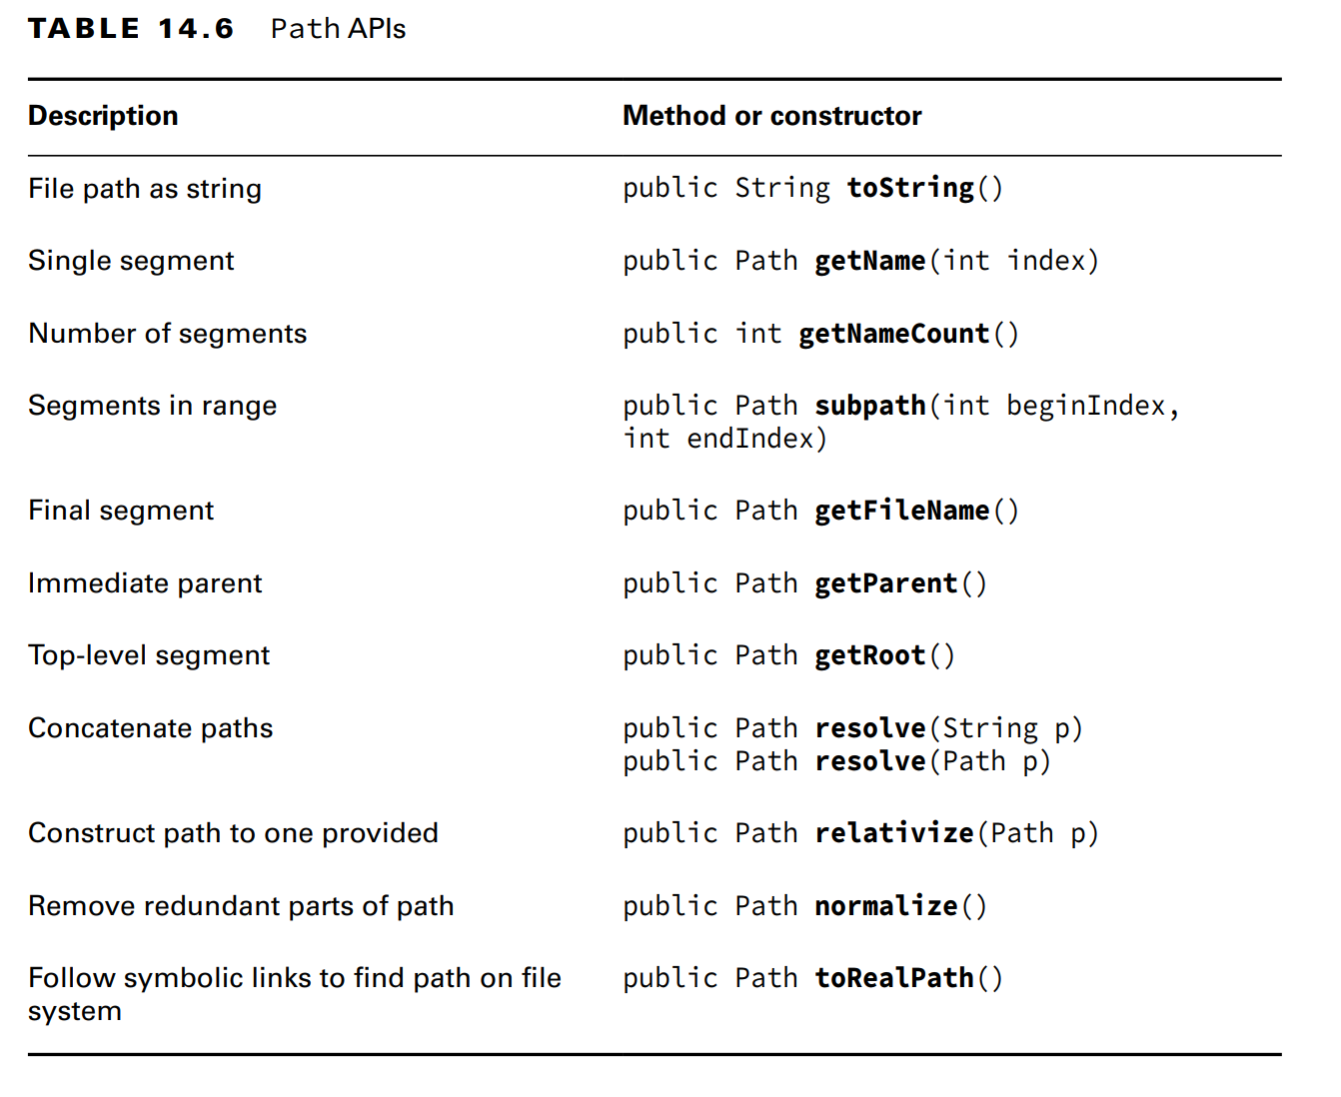
Chapter 14 - IO
Reviewing NIO.2 Path APIs

Slide 25
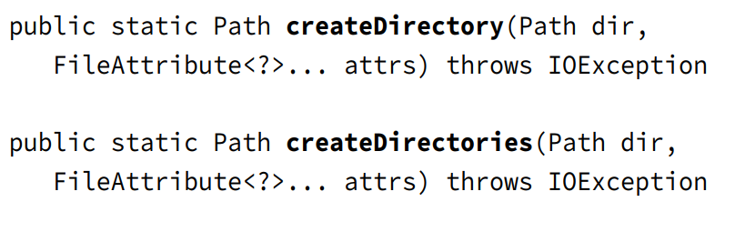
Chapter 14 - IO
Creating, Moving, and Deleting Files and Directories
Making Directories
- To ..., we use the following ... from the ... class

Slide 26
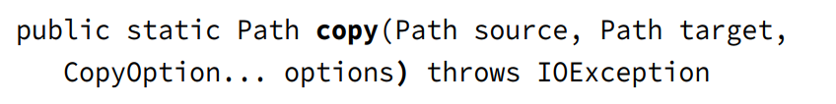
Chapter 14 - IO
- The method ... will create ... and throws ... if ... or ... that contain doesn't ...
– The method ... will create ... along with ... if they aren't ... (if all ... then the method will ...)
- The method ... will useful when we need to make sure a ... is ... and ... if it is not ...
- Both method recieve a FileAttribute<?> to ...
(code illustration snippet 26)
Copying Files
- The ... class also includes a ... to copy .../... from ... to ... (note: the copy path must be ...)

Slide 27
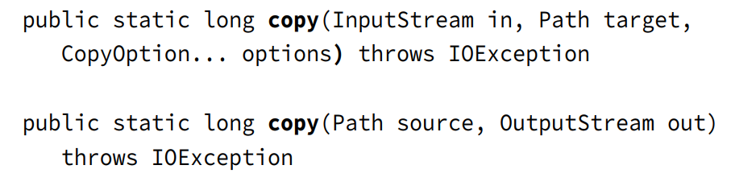
Chapter 14 - IO
(code illustration snippet 27)
- When directory is copied, this copy is ... (it means ...)
- A ... copy means all ... (it means ...). ... copy requires ...
(code illustration snippet 28)
Copying and replacing files
- By default, if ... existed then the method ... will ..., but we can this behavior by ... StandardCopyOption ...
- This option will ...
(code illustration snippet 29)
Copying Files with IO Streams
- The ... class has 2 methods ... working based on ...

Slide 28
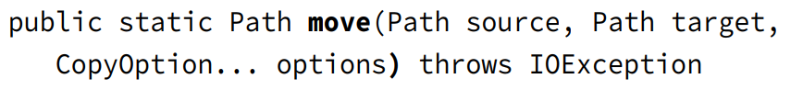
Chapter 14 - IO
- The first method will ...
– The second method will ...
(code illustration snippet 30)
- Although we use a FileInputStream in the previous example, it could be any ... valid ... including Web .., in-memory ...
Copying Files into a Directory
- For the exam, we must understand that the ... method works on both ... and .... If we have a file called food.txt and a directory called /enclosure, then what happen if we run the code ?
(code illustration snippet 31)
- This code won't ... into the ... it will instead throw ... because the ... exist
– On the other hand, if the ... not exist => it will ...
- This is the correct way
(code illustration snippet 32)
Moving or Renaming Paths with move()
- ... class also provide a method used to .../... .../...

Slide 29
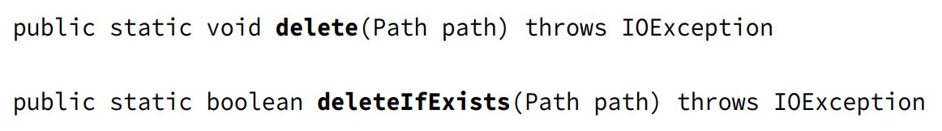
Chapter 14 - IO
- If both of the ... are ... => ...
(code illustration snippet 33)
Similarities between move() and copy()
- Just like ..., ... must have ... option if the ... already exist to over ... And just like ..., ... also won't if the target is a ... and the argument is a file
Performing an Atomic Move
- Another enum we must know is ... which is from the ... enum
(code illustration snippet 34)
- Atomic here means ... from Chapter 13. Atomic here means the move ... is considered as a single ... by other threads they don't look that this as a partially ...
- If ... system doesnt ..., then it will throw AtomicNot...
Deleting a File with delete() and deleteIfExist()
- The ... class include ... methods to delete .../... in the ... system

Slide 30
Chapter 14 - IO
- To delete a ..., that ... must be empty. Both .. will throw .. if the ... is not ...
– Moreover, if the argument is a ... link => then that ... is ... not the ...
- ... will throw if the ... exist
- ... wont throw if the ... exist
- ... is useful when we need to make sure that the ... is ... exist and ... if it does
(code illustration snippet 35)
Comparing Files with isSameFile() and mismatch()
- Because a Path could include ... and .... The method equals() is not reliable when ... if both .. refer ... same ...
- Luckily, Java has the ... method which recieve 2 ... (this method will resolves ... and ...) and check whether ...
– In most cases, ... will throw if ... exist, but there is a case where ... (2 path ... completely same ... => check without ...)

Slide 31
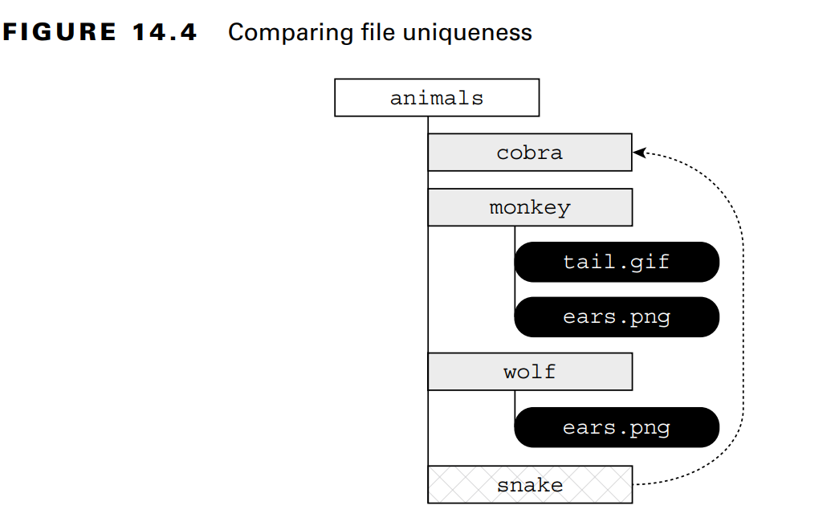
Chapter 14 - IO

Slide 32
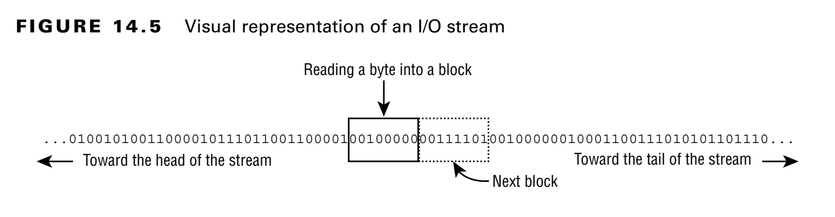
Chapter 14 - IO
(code illustration snippet 36)
- Sometime, we want to check the ... of the ... instead of its physical ... => We can use ... method, it will return ... if both ... otherwise, return the first ... where ...
(code illustration snippet 37)
Introducing I/O Stream
- Now we will talk about ... In this section, we will talk about how to use ... to .../... data. IO is a word used to ... the nature of ... or ... the data from ... or ... the data to ...
– When talking to ... we meant the ... java.io ... If we just use Stream then we will be ...
Understandinbg IO Stream Fundamentals
- The content of a ... can be ... through ... Stream, this is a list of ... in order ... An IO Stream can be visualized as ... water ... with ... as waves ...

Slide 33
Chapter 14 - IO
- As the image above, we can see that the IO ... is so large that we can't ... We only have a ... the current position of ... in the ... at a ...
– Each type of ... divide data into multiple ... with multiple ... For example, some IO ... will read data as, some IO ... will read data as ..., or a String. There are also some IO ... read a large group of .../... at the same time, especially with IO that has ... in its name
– Although java.io ... contains a lots of ... that handle bytes,...,.... at the same time, these ... are all based on the ... handling mechanism or ... array ... Most of these high-... are served as a more ... version or improve ...
– Although IO ... are usually used with File ..., it is used to handle ... with any ... in order ... (for example, we can write a Java ... that send a ... website and read ... through an input ...
IO Stream can be big
- When we write code, we dont usually know the ... of the ... at runtime. We can image that it is a very ... that cant be stored in ... (for example, ... 1TB ... cant be ... in ...., of course except ...). However, that large ... can still be ... normally by a program with little ... It is because, the IO ... focus on a small ... at the time ...
Learning IO Stream Nomenclature
- java.io API provides a lot of ... for .../.../... the IO ... (so much that it can makes a Java dev ...)
- Even if we cant recognize a ..., we still can determine ... through its ... (and even its .... too)
- The target of this chapter is to familiarize us with ... IO ..., convention ... when working with ... IO

Slide 34
Chapter 14 - IO
Storing Data as Byte
- Data is stored in a File ... (and in ... too) as .../..., we call this as ... Because .../... data based on .../... is so hard and time-consuming, so we combined a group of 8 ... and we call it a ... What about Java primitive ... ? Later on, when we study about how to use ..., we will see that the IO use .../... array to .../... data
Byte Streams VS Character Stream
- java.io API defines 2 ... of IO ...
+)
+)
– We will use both ... in the chapter
– These API usually have common ... (FileInputStream VS FileReader). The difference between them is how the byte is ...
- An important thing we need to remember is that although the name contains ... in it, it is still technically an IO .... We just use names to distingush between ...
– In this chapter, we will use ... and ... as input stream and ... and ... as output stream
– Byte ... is usually used to handle data such as ...,... while character ... is used to handle ... data (for example, we can use a ... class to write the data to ... without concerning about the ...)
– Character ... willl determine how ... decoded and stored as ... in an IO ... Although it sounds ... but Java support a lot of ... from 1 byte .... like ... to ... >= 2 bytes such as ...(for the exam, we just need to know ... not ...)

Slide 35
Chapter 14 - IO
Character Encoding in Java
- In Java, ... can be specified using the ... class by passing the name to the ... method
(code illustration snippet 38)
- Java supports a lot of ..., each is specified using ...
Input VS Output Streams
- Most of the ... has its counterpart ... and vice versa. For example, we got FileOutputStream, then we will got ... too. If we understand the mechanism of ..., we can understand the other ... and vice versa
– Same rule, ... class also have ... class (for example, File ... write ... that can be ... by ... File ... class)
- However, there are some ... for this rule. For the exam, we must remember that Print ... doesnt have Print... Same as that, Print ... doesn't have its ... counterpart (we will talk about this class later ...)
Low-level VS High-level Streams
- Another way to remember ... in Java is to classify them into ... and ... Streams
– ... Stream ... directly with the data in a ... and ... manner
- On the other hand, ... Stream is based on another ... Streams using something called ... technique. ... technique is a process of passing an Instance of ... into the ... and all operations on the ... will be ... and passed down to the ...
(code illustration snippet 39)

Slide 36
Chapter 14 - IO
- In the previous example, FileReader is ... and BufferedReader is a ..., which recieve ... as an input. Many operations on ... have been passed down to the ... such as ...(), ...(). The other operations .../... new functions for the ... IO methods
– The ... IO Stream can add ... methods such as ...() as well as measures to improve ... the IO ...
- Some ... IO can also recieve other ... IO as well as input ..
(code illustration snippet 40)
- In this example, FileInputStream is ..., which is ... in a BufferedInputStream (to improve ...), and both of them got ... into an ObjectInputStream, allowing us to interact ... as an ...
- For the exam, we must remeber that the ... IO stream is the stream classes that works with ... and other non-... class are all ... IO classes
Stream Base classes
- java.io library defines 4 classes that is the ... of all ..
+)
+)
+)
+)
- Constructors of high ... usually takes a reference to these ... (for example, BufferedWriter recieve a ... as an Input => allowing any ... as an argument)

Slide 37
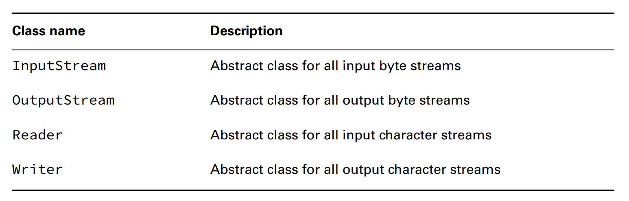
Chapter 14 - IO
- A trick that the exam usually use is that they mix ...
(code illustration snippet 41)
Decoding IO Class names
- Be careful when seeing the name of the ..., it can tells you ...,... of the class (for example, a class with ... name will ... or a class with ... name will ...)

Slide 38
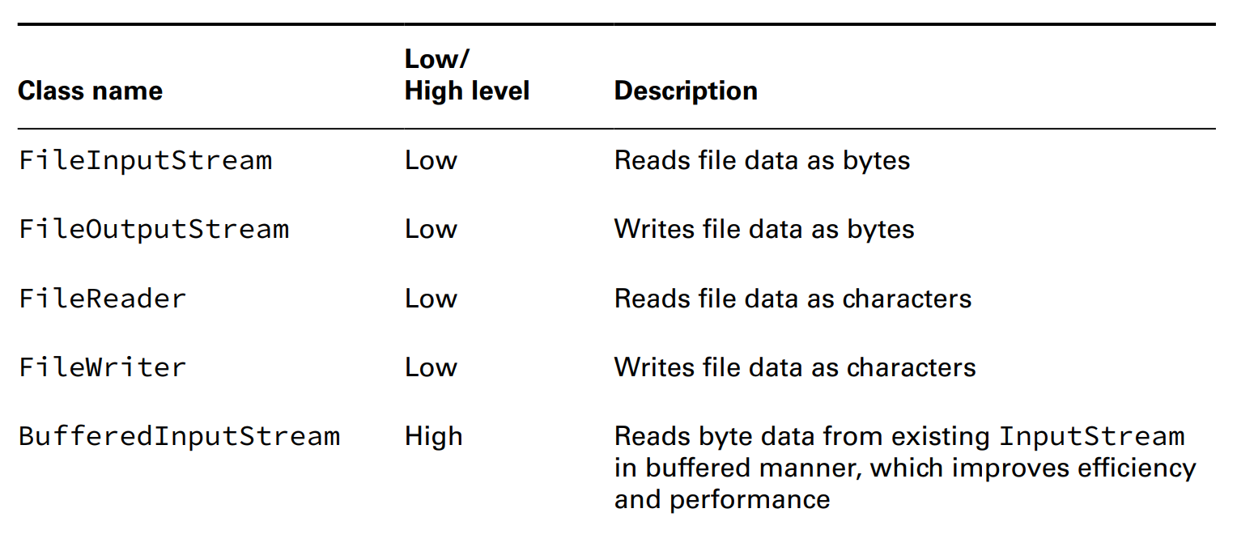
Chapter 14 - IO

Slide 39
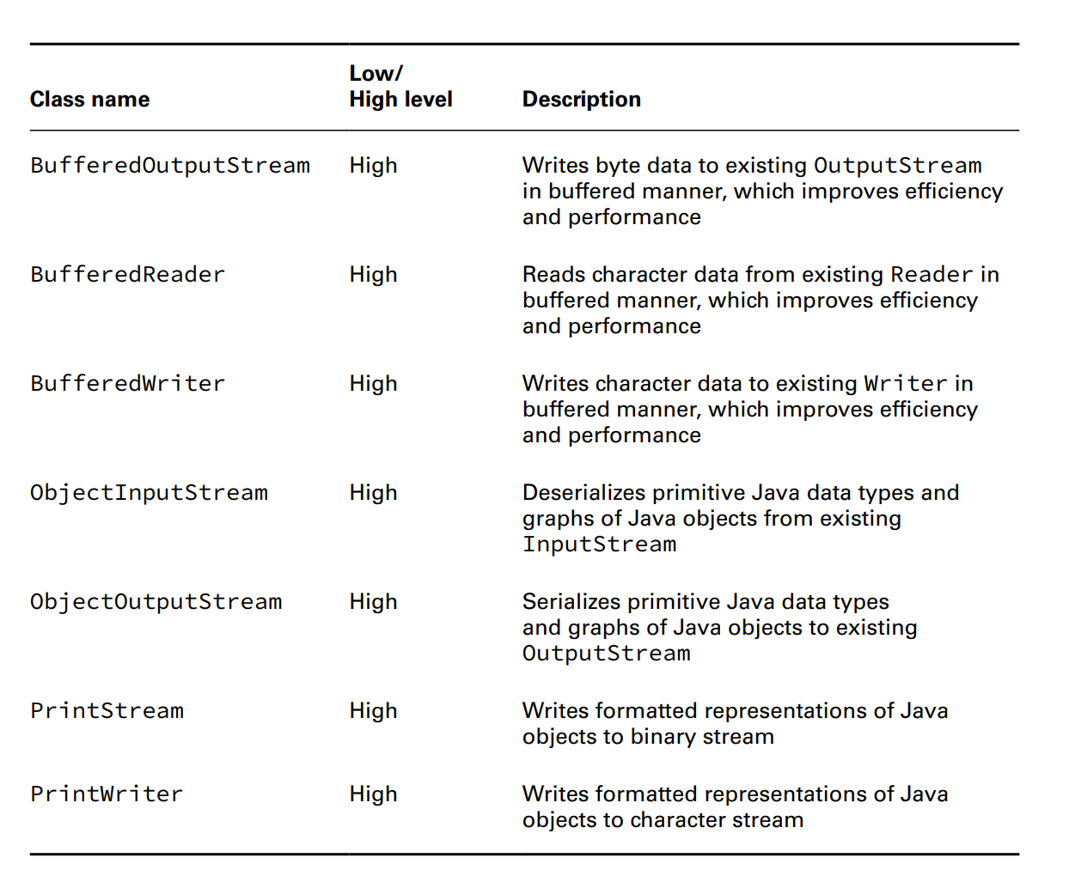
Chapter 14 - IO

Slide 40
Chapter 14 - IO
Reading and Writing Files
- There are many way to .../... data from a ..., we study about them in this section by ... from ... to another...
Using IO Streams
- IO ... is mostly focused on ..../... data, so there will be no suprise to us that .../... declares a method ...() used to read the ... data from IO ... and so, .../... also declares a method ...() to write the ... data to a ... IO ...
- The method copyStream() down here will read all ... and then write ... to ... IO .../... In both example, we can see that the method use the ... to notify that this is the end of ...
(code illustration snippet 42, 43)
- However, there is a problem. We have been told that we are .../... byte, then why the method uses ... ? We must remember that a byte can ... characters, it requires a value to signify the ... The Java devs decided to use a larger ... which is "int" => Larger value will be used to signify the ... of an .... Output ... also use the same ...
– Moreover, .../... on single ... is not ... Luckily, ...() has an overloaded ... which allows us to ... multiple ... at the same time. Parameters such as ..., ... are applied to the ... array (for example, ... 3 and ...5 means it will ... 5 ... at the same time and append to the ... starting at ... 3.... )
(code illustration snippet 44)
- Instead of ... single ... at the same time, we will ... at the same time. The value lengthRead is very important because it determines is it the ... of IO ... and determines the number of ... we need to write to ...

Slide 41
Chapter 14 - IO
- Unless the file size is exactly ..., the last iteration of ... will write ... smaller than ... (for example, if the ... 1054 bytes, then the last ... will be ... smaller than ...). If we ignore the value ..., then the final ... will have the size of ... but with additional of ...
- We also include a method named ...(), which mitigate the ... loss when ... suddenly ... When data is ... output, the OS cant gurantee that the data is ... file system immediately. The method ...() will request OS to ... still inside ... to be written ... However, the usage of this method comes with a cost, every time we call .. will ... substantial ... to the app (especially with ...)
- We only use this method when ... critical ..., otherwise, ...() should be used intermittently
- The method that looks like ...() also appear in .../... but these 2 read/write ... instead of ...
– Our previous example only makes us feel ... because it use ... only
(code illustration snippet 45)
- The crucial point here is that we need to choose high ... that is most ... to us. In this situation, we are working with a ... => We want to use File... and File... Both class has ... that recieve a String representing ... or a ... instance
– If the ... exists, a ... will be throw (which is a sub... of ...) If the desination file exist, it will ... We can pass an optional ... (2nd ... ) to the File... to .. change the append flag ... bahavior
– We can also choose to use Buffer... and Buffer... so that we can read the whole ... => Give us an advantage of ... the whole ... without the need to write the whole ...
– write(line) will ... the whole ... and remove the ... newLine() will ... back (the example also include try... to ... and ... technique)

Slide 42
Chapter 14 - IO
- Now, assume that we want ... data instead of ... data => We must pick other choice of high ... which is Buffered... and Buffered... or File... and File.... With these class, we can call readAllBytes() instead of ...() and the result will be saved in a ... array instead of a ... And finally, we don't need to handle the ... because the data is just ... now
- We can improve the previous example, which used Buffered... and Buffered..., by using something called Print... and Print...
– There are ... key methods in ...
+)
+)
+)
+)
– The last 2 method we will mention it in the ... part
(code illustration snippet 46)
- In this example, the method ...() used the String ... There are many ... covering from ... datatype to ...
– Inside method ...(), they just simply do String...
- All print stream classes are different than the normal ... because they are IO ... and they don't have ... counterpart. Also, differ from the ... classes, Print... doesnt have ... in its name

Slide 43
Chapter 14 - IO
- There is a thing that will make us suprise that we have been using ... for ... Both ... and ... are part of the PrintStream class. Moreover, the System.in is also useful in ...
– Differ from most of the IO ... that we have ..., methods in the ... classes don't throw .... If it does, then we have to ... everytime we ...
- The line separator such as ... or ... depends on OS => ...() method will handle this for us, if we need to get the ... directly, we can use ...
(code illustration snippet 47)
Enhancing with Files
- NIO.2 API provides a very easy way to ... instead of using the ... class. Let's start with the first ... methods used to ... files by read ... and write ...
(code illustration snippet 48, 49, 50)
- These methods look pretty short, we can read a Path as ..., ..., .... Please be advised that these method will ... at once => Save the file to the ...
– If the file ... enough, it will trigger ...Error. Luckily, we have a solution for this. The example below will print out ...
(code illustration snippet 51)
- This method will read all ... and print ...
– Because Stream is ... => File didnt ... into ...

Slide 44
Chapter 14 - IO
(code illustration snippet 52)
Files.readaAllLines() VS Files.lines()
- For the exam, we must know the difference between ...
(code illustration snippet 53, 54)
Combining with newBufferedReader() and newBufferedWriter()
- Sometime, we will need to use both ... and ... => ... class include ... to do that
(code illustration snippet 55)
- Of couse we can use the ... technique to achieve ..., however, using ... method is much more ...

Slide 45
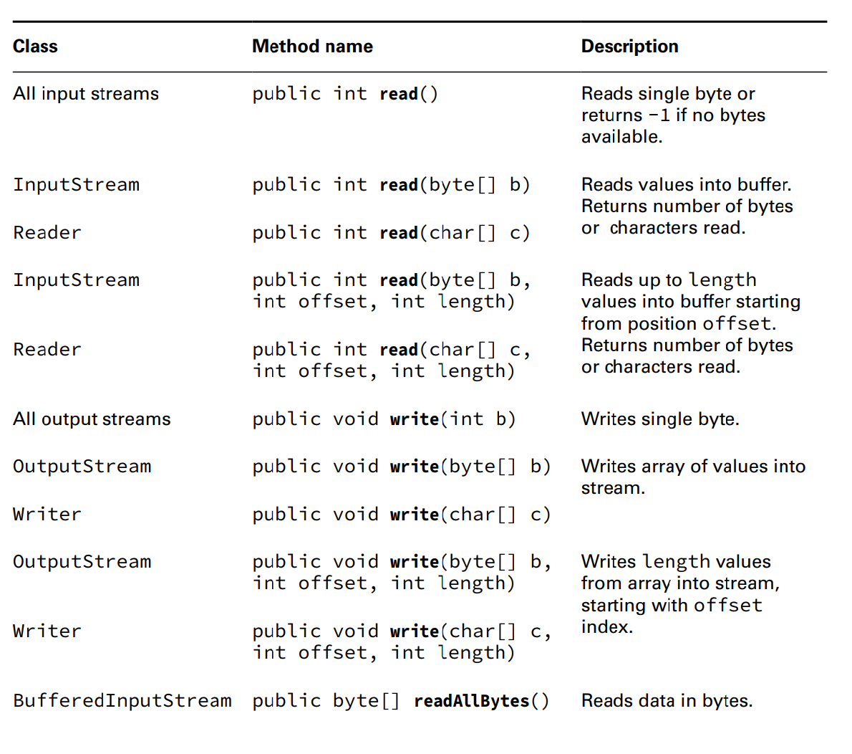
Chapter 14 - IO

Slide 46
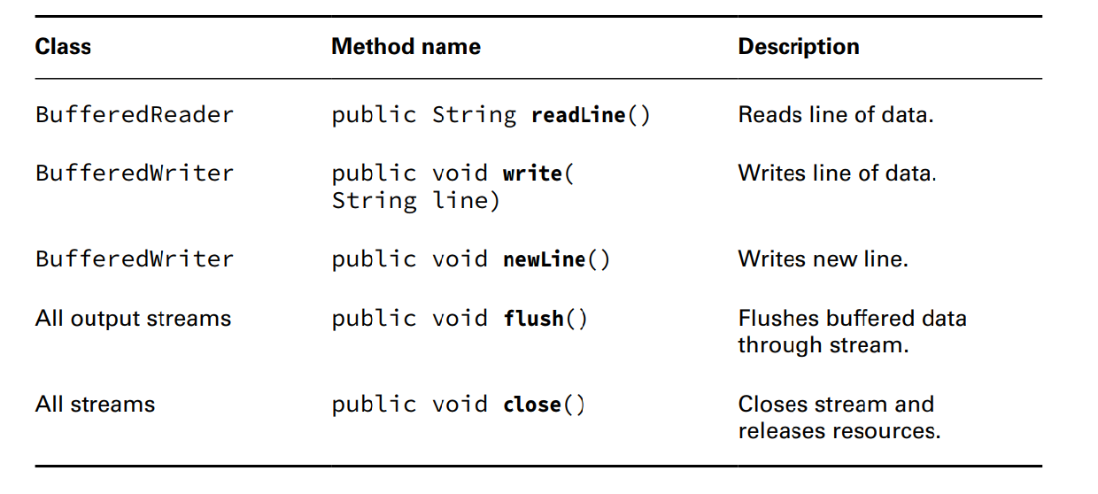
Chapter 14 - IO

Slide 47
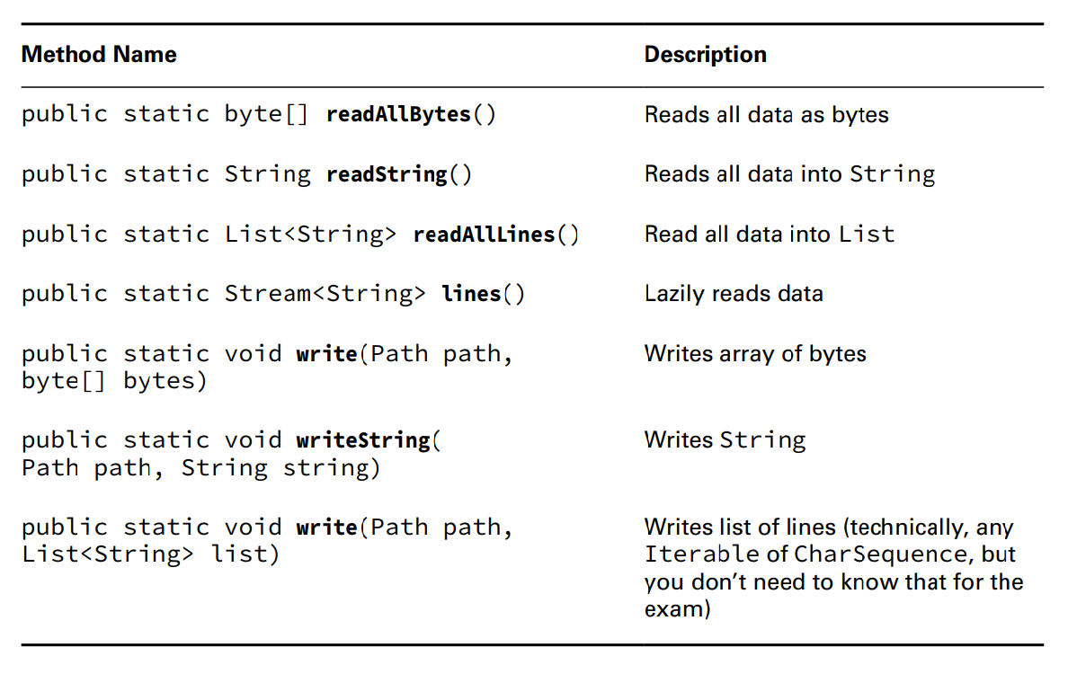
Chapter 14 - IO

Slide 48
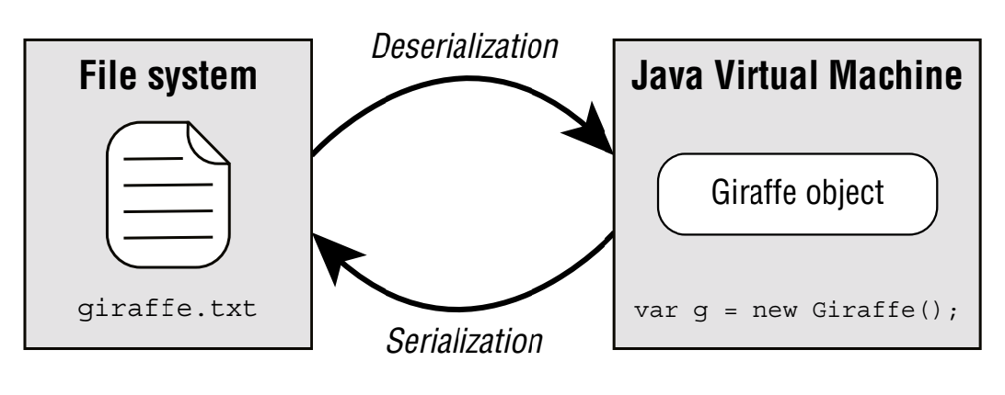
Chapter 14 - IO
Serializing Data
- Throughout this book, we have manage ... using class => we want to maintain ... throughout the execution of ... Our data will just ... if we have to ... again when ... run
– There is a way to ... is by using the IO ... that we have study to save ..., binary data, but we still have to design a mechanism to ...
– We can also refer to other solution such as ...,..., but anyway, we still have to find a way to ...
– A brand new solution to this is thst we will ... to convert ... to ... ... is a process of converting in-memory ... to ... byte ... ... is a reverse process where ...

Slide 49
Chapter 14 - IO
Applying the Serializable Interface
- To ... an object using IO API, the object must implement ....
- Serializable interface is a ... interface, which means it doesnt have any .... Any class can implement ... because it doesnt have ...
- If Serializable is an ... interface and any ... it, why dont we apply it to all ... ? Technically, we should only allow ... for classes that are ... not .... Such classes like ...,... aren't designed to ... because its internal state is ...,...
- The purpose of ... interface is to inform the ... that trying to ... that we have ... proper ... to ensure ...
– All Java ... along with built-in ... are ...
(code illustration snippet 56)
- In the previous example, Gorilla class contain ... instance members (...) that will be ... if the object is ... (the ... interface is in the ... package, we must ... before ...)
- The field "favoriteFood" marked as ... which mean that ... saved in the ...
Maintaining a serialVersionUID
- A good coding practice we must know is that we should ... static SerialVersionUID in all ... that implement ...
– This field is archived with ... during the ... process. Each time the ... structure changes, then this value will be ... or ...
- For example, if the Gorilla classes recieve a new ... double Banana or the ... field is changed => The idea is that the .. might be ...ed with the old ...

Slide 50
Chapter 14 - IO
- The ... will inform the JVM that the ... in the IO doesnt match with the current. If there are any older version that ... during the ... process, a java.io. ... will be thrown. Moreover, some of the API supports migration between ...
Marking Data transient
- ... modifer can be used to sensitive ... in class such as ... There are other ... that are not designed to ... such as Thread. If these objects are needed to ..., we can mark ... transient if ...
– What happen with the ... when the ... process happen ? It will assign default ... such as ... for ..., ... for ... and ... for ...
– Marking a ... field ... doesn't mean anything. Other than the serialVersionUID, only ... are saved during the ... process
Ensuring That a Class is serializable
- Because ... is a marker interface, we can think that there are no ... when ... => Wrong, because every process that try to ... an Object that ... improperly
+) The class must ... interface
+) All instance ... must be ... or marked ... or have a ... value during the ... process
(code illustration snippet 57)
- If we want ... => we must ...
(code illustration snippet 58)

Slide 51
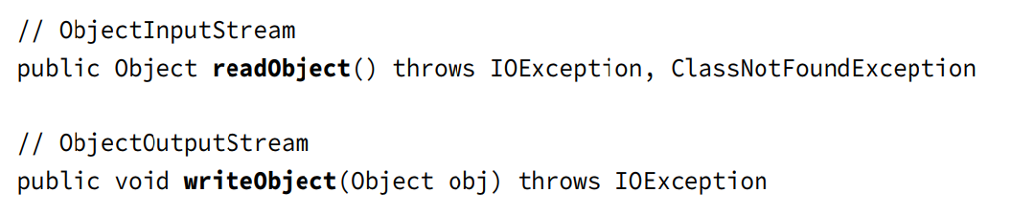
Chapter 14 - IO
Serializing Records
- In order to ... a Record, we just need to simply ...
(code illustration snippet 59)
Storing Data with ObjectOutputStream and ObjectInputStream
- ObjectOutputStream class is used to ... while ObjectInputStream is used for ... process. All of them are all high ... working based on a low ....
- While both classes contain methods used to work with the ... in Java, there are 2 ... we need to know that works with ...

Slide 52
Chapter 14 - IO
(code illustration snippet 60)
- We can see that we also ... in a Buffered... to ...
– Once the ... saved into a ... , we can ... by using the following ...
(code illustration snippet 61)
- This method ... complicated than the one used to ... object. When call ...(), the values like -1, null doesn't mean anything because the dev can ... the object using these ...
– Differ from the ... method, we have to use ... loop to ... the data and it will throw ... if it reaches the ... of the IO ...
– If our program know exactly ... then we can just ... a number of time instead of using ...
– Because the ... type of ...() is Object, we must check ... because accessing it ... ...() also throw a ... if the class doesnt ... during the ... process
(code illustration snippet 62)
- ObjectInputStream inherits a ... from its ... InputStream called ...(). We might think that this method is used to check if this is the end of ... and it won't throw ... Actually, this method will only let us know that amout of ... without blocking other ... => It might return 0 even if ...
Understanding the Deserialization Creation Process

Slide 53
Chapter 14 - IO
- For the exam, we must know how a deserialized ... is ... When we ... an object, its ... along with its ... are not called. Java will call the no-arg ... nearest non-... class that it can ... in the class hierachy. In the previous example with the Gorilla class, the nearest ... is the ... class
- As we said earlier, all ... fields are ignored. All other fields if ... will be assigned ...
(code illustration snippet 63, 64)
- The output still prints out "B" is because ...
– If we have the ... file and we run it again without ... => The result will be ...
– For the exam, we must remember that ...,... in the ... class are all ignored and Java will ...
(code illustration snippet 65)
- This subclass is still ... because the ... implement ... while the ... remain the same...
Interacting with Users
- Java includes many classes to ... users (for example, we want to make a program ask user to ... and then print out the ...). This section will cover many techniques used to handle the ...
Printing Data to the user
- Java includes 2 instances to provide ... for user (... and ...) While we are all ... with ..., ... are pretty new with us ... The syntax to use ... are also the same with ... but it is usually used to ... error for user in a separate IO ... from the ... IO ....

Slide 54
Chapter 14 - IO
(code illustrations snipept 66)
- What is the difference between ... This depends on the environment ... the program. For example, if we run in ..., both ... will produce the same ... On the other hand, if we run ... in ..., ... different ... Finally, if we run the code on the server, the ... will probably ... log onto the other file ...
– While both ... are really useful in ... and ..., they are rarely ... in professional .... In professional ..., they usually use ... service or API. Although there are many ... API, most of them share the same .... The first thing we need to do is to create a ... for each ... and then logging the ... according to each ... (...(), ...(), ...(), ...()). 2 ... likes ...() and ...() are really useful for non... but might be ...
Reading Input as an IO Stream
- ... return an InputStream, which is used to recieve ... from ... It is usually ... with an InputStreamReader and also ... in BufferedReader, in order to ... method ...()
(code illustration snippet 67)
- When we run this code, the code will ... until the user ...
Closing System Streams
- We can notice that we never ... ...,...,... when using them. In fact, these are the only IO ... that we never use with ...
- Because these are ... object, they are ... in JVM. JVM will ... these ... and ... these properly (or we call ... by ourselve, although the call for ... is not ...). Closing ... will permenantly ... by other ... in the program

Slide 55
Chapter 14 - IO
(code illustration snippet 68)
- This code won't .... The method ...() wont throw any ... and it also depends on ... to ... error => it will .. silently
(code illustration snippet 69)
- This code is also won't .... Just like ..., ... is also a Print... and even if this code does throw ..., we can't see it because we have ... => Close the ... is a bad idea because all ... of the error are hidden
(code illustration snippet 70)
- This code will ... at runtime because differ from Print ..., most of the ... will throw ... if we try to ...after it has been ...
Acquiring Input with Console
- java.io.Console class is ... specifically to handle user .... After all, ... and ... are all just a normal ... while ... is a class comprised of all ... focused on ... user ...
– Console class belong to ... type because we can only access its ... and there will be only 1 ... by the JVM => We can't use the ... because ...
(code illustration snippet 71,72)
- ... object will sometime not ..., and this depends on the .... (for example, if we run ... on ... then ..., if we run ... on ..., then ...). If the ... object not ..., the ...() will return ... => We must always check the ... before using it ...
- This exmaple is trying to get the ... and check ... If it is not ... then, if it is ... then ...

Slide 56
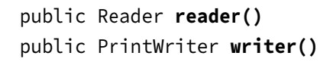
Chapter 14 - IO
Obtaining Underlying IO Streams
- The ... class provides access to ... to .../... data

Slide 57
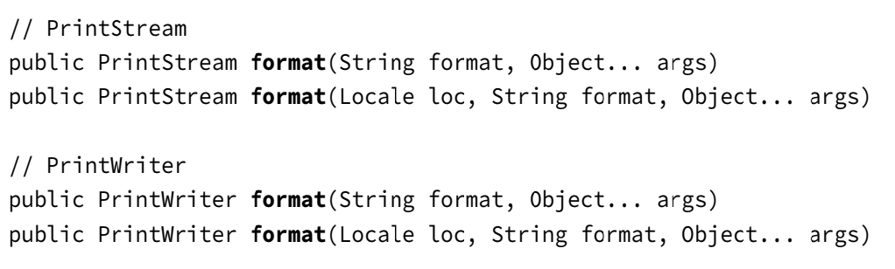
Chapter 14 - IO
- Accessing to these ... is no difference than using ... and ... except that we will use ... IO ... instead of ... IO ... => These ... IO ... will be much better when handling ...
Formatting Console Data
- In chapter 4 we have learn about ... and in chapter 11 we have learn about ... using ... too. More conveniently, some print stream classes also include a ... ...() used to ... which its own ... version also included a ... for better ...
– To make C devs much more ..., Java also includes ...(), which is completely the same as ...() and these2 guys are ...

Slide 58
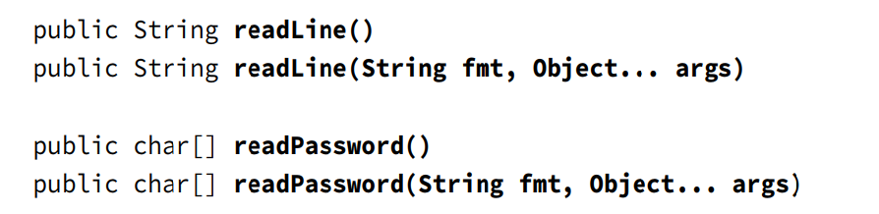
Chapter 14 - IO
(code illustration snippet 73)
Using Console with a Locale
- Different from the ... class, the ... class doesnt include a ... version for the method ...() which recieve an additional .... ... class will use the default ... However, we can get the ... class through the method ...() to use the ... version from the ... class
(code illustration snippet 74)
Reading Console Data
- The Console class contain ... methods to get ... from ...

Slide 59
Chapter 14 - IO
- Just like ... wrapped in Buffered..., ...() will continuously ... until user ..... The ... version of ...() also print out the ... version from ... input ...
- ...() is the same as ...() with 2 keys difference
+) won't be ...
+) stored in ... instead of ...
– Why does ...() has to do that ? Because if the ..., other will ... and if they stored in ... instead of ..., the password will be stored in ...
Reviewing Console methods
(code illustration snippet 75)
Working with Advanced APIs
- In this last part, we will talk about some advanced ... of IO and NIO.2 which can be useful in ... and can appear in exam
Manipulating Input Streams
- All types of ... classes includes these ... to change the current ...

Slide 60
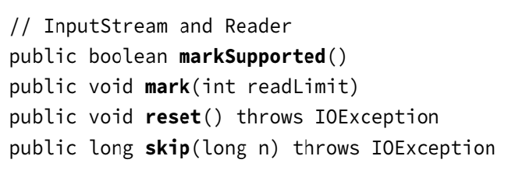
Chapter 14 - IO

Slide 61
Chapter 14 - IO
Note: In general, the mechanism of these 4 methods are ... but depends on ..., the ... may be different
- Not all ... supports ...() and ...(), make sure that these ... by calling the ...() method, or else we will got exception
Marking Data
- Let's assume that we have an ... with the next value is LION
(code illustration snippet 76)
- If IO Stream ... then it ... LIOION, but if ... then ... LION
- It is a good coding practice to arrange ... match with expected ...
– The value 100 in the ...() method will inform the ... stream that we are expecting ... at maximum .... If the program didnt ... then ... chances of throwing ... depending on which ... we are using ...
- Technically, ...() and ...() don't ... into the IO ... but these ... saved in a ... so that they can be .... => That's why we shouldn't call ...() and ...() with such ... because it is ... memory
Skipping Data
- Continuing our assumption that we have an ... with the next value is TIGERS
(code illustration snippet 77)
- If we ...() but we didnt => it is just equivalent of ...(1)
- The ... value of ...() give us how much ... skipped (for example, if we are near the end of IO ... and we call ...(1000), only 20 ... actually ...)

Slide 62
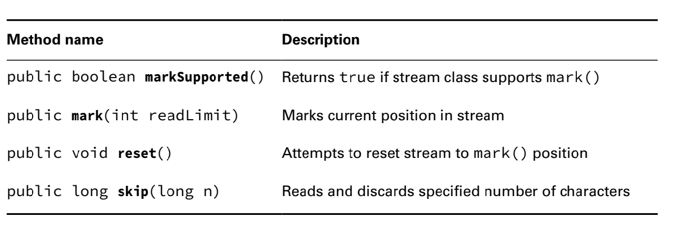
Chapter 14 - IO
- The ... is very important it allows us to know where ... and how much ... processed

Slide 63
Chapter 14 - IO
Discovering File Modules
- We will talk about ... used to read file ... These ... can be used in any ... although they are a little bit useless
Checking Symbolic Link
- Earlier in this chapter, we have seen that the Files class contain the method ...() and ...() (similar to isFile() and isDirectory() from ... class) While these methods in ... class can't tell us whether this is a ... or not, the method ...() from ... class can
– Also, both method ...() and ...() from Files class can tells us whether this is a ... or not
(code illustration snippet 78)
Checking File Accessibility
- In many file ..., we can set some boolean ... for a file to mark it ...,...,...,... The methods in the Files class can get ... which is ...(), ...(), ...(), ...()
– A hidden ... can't ... normally while we listing the ....
- ...,..., and ... are very important in file system because file name can still be ... but user can't ...
(code illustration snippet 79)
(Note: A file extension can't ... whether a file is ... or ...)

Slide 64
Chapter 14 - IO
- With the exception of ...(), all other methods will ... if the path ...
Improving Attribute Access
- Up until now, we have access separate ... by calling .... While this is completely ..., it comes at a cost
– To put it simply, our program will have better ... if we ... at once instead of ... Moreover, there are some ... specifically for each file system ...
– NIO.2 has ... by building a "..." for multiple file system with only a single ... A view is a group of .... related to a specifc file .... Despite that, other methods we have learned are not completely ...., if we only need a single, then those ...
Understanding Attribute and View Types
- NIO.2 includes ... methods for us to work with ... with only a single ...
+) ... for read...
+) ... for upda...
– For each method, we need to provide a ... object, signifying the NIO.2 method that we ... this ...
– Updateable view means ...

Slide 65
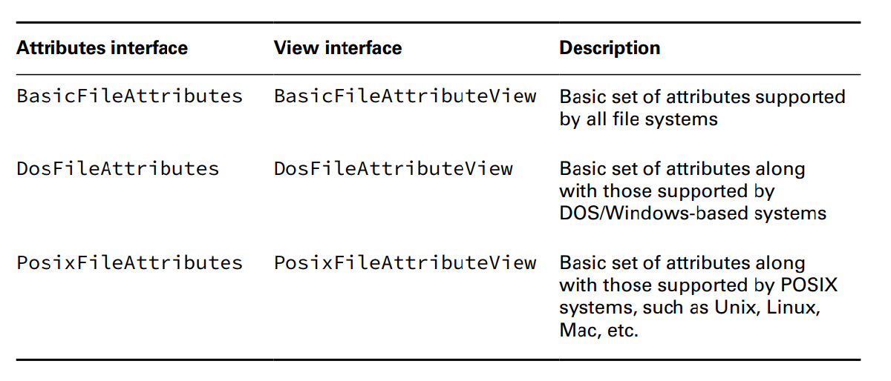
Chapter 14 - IO

Slide 66
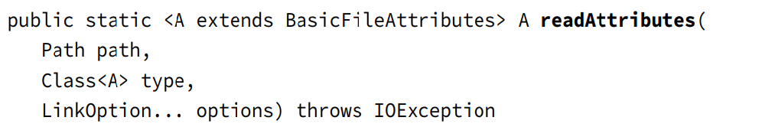
Chapter 14 - IO
Retrieving Attributes
- The ... class includes this method to get ... in a ... manner

Slide 67
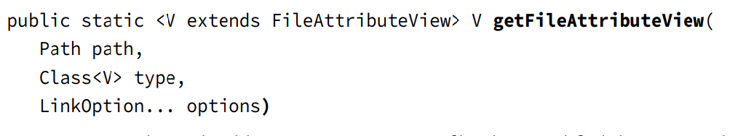
Chapter 14 - IO
- To use it, we are requested to pass in a ... and a ... object
(code illustration snippet 80)
- The ... class includes a lot of ... just as like methods in the ... class but differ from that method, this one only need to request only once on some ...
Modifying Attributes
- This method in the ... class return a ... view

Slide 68
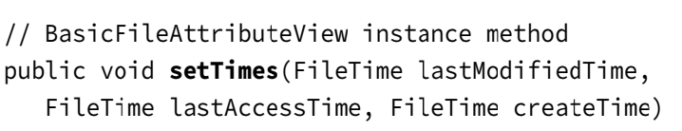
Chapter 14 - IO
- We can use this ... to modify ... (adding 10s or 10000ms to ...)
(code illustration snippet 81)

Slide 69
Chapter 14 - IO
- This method allows us to pass ... for any ... that we don't ... In this case, we only need to change ... so the other ....
- Not all of the ... can be ... through the ... view (for example, you cant change the ... to change a ...to a ... or change the size ... without ...)
Traversing a Directory Tree
- While Files...() is very useful when ..., it can only ... of a single ... How can we ... through the entire ... ? Before we continue, we must understand about the basic of the file ...
– Directory is organized in a ... manner (a directory contain ..., ... contain ..., etc...)
- Each record in the ... has only 1 ... (except the ... directory)
- File ... usually visualized as a ... with a big ... and many ... (in this model, directory is ... (.... node) and file is ... )
- A common task in the file ... is to loop through the ... and record the ... or more commonly, ... them to get a specific set of ... that has extension of ".java" (more over, file ... store files in a ... manner) => In general, we must start from the parent ... and go through all child ...)
- Traversing a Directory – or ... is a process we start from ... and go through all until we ... or ... (for example, we are searching for a single ... and we can stop the search once ... or ...)
- Path we used to start will be ... and usually, the searching will cost ...

Slide 70
Chapter 14 - IO
Don't use DirectoryStream and FileVisitor
- When we going through the documentation of NIO.2, we might encounter some ... that use ... and ... when doing the ... task. These method are way back when Java doesnt have ... and usually asked in older Java exam => We are not recommended to use them because newer method uses ... which is ...,... and still ...
Selecting a search strategy
- 2 methods used for the ... task are ... and ...
- ... will go through the ... from the ... to any ... and then come back to the ... (going through all .. it has skipped). The Search ... is the distance from ... to ... To prevent the infinite ..., Java uses a ... to limit how many nodes it can ...
- ... will start from the ... and go through all ... with different search ... The result will be sorted in ... depth 1 -> depth 2 -> ... Although ... is pretty ... and ..., it requires more memory because it must maintain ...
– For the exam, we don't need to know BFS/DFS, we just need to know that NIO.2 ...-based method use ... along with a version for custom search ...
(note: Root here means ... not the ... directory)

Slide 71
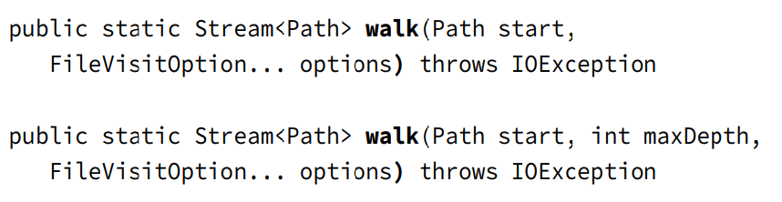
Chapter 14 - IO
Walking a Directory
- The ... class includes ... methods to execute the ... task using the ... algorithm

Slide 72
Chapter 14 - IO
- Just like other ... operations, walk() use ... evalutation from Stream and only ... a Path once it arrives. This means that even if a directory ... includes hundred of ..., the amount of ... consumed is ...
- The first ... method uses the default Java ... search ... which is Integer.... while the second one use the custom ... (the 2nd version is useful when we know that our ... we need to find is near the ...)
- This time, instead of print the ... of the directory, we will calculate the ... of all files in ...
(code illustration snippet 82)
- We have to create a ... method because ... throw ... and we don't want ... => Put it in a separate ...
- We can print the ... result using ... method
(code illustration snippet 83)
Applying a Depth Limit
- We can add another ...

Slide 73
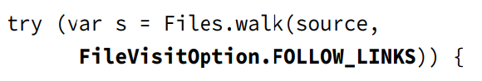
Chapter 14 - IO
- This means that starting from the ..., we can ... maximum of ...
– Because this method calculates the size of ... => If we set it as 0 => the result will be ... and if we want a non-... result, then the ... must be != 0
Avoiding Circular Paths
- Most of the method in NIO.2 always ... link, and this can be changed with the ... option. However, the method ...() won't ... link by default and it must have ... option to ... link

Slide 74
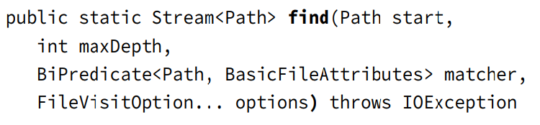
Chapter 14 - IO
- When executing the ... task, our program must be very careful with ... link (for example, if we are in the ... process and we encounter a ... link and this ... root ... => the entire .... Even worse, if this ... link point back to a... that has been ... => we got a cycle, which means ... (even chaning the algorithm won't ...)
(code illustration snippet 84)
- After the ... option is used, ...() will track all ... that it has gone ... and ...() will throw FileSystemLoopException if ... twice
Searching a Directory
- In the previous example, we have applied a ... to the Stream, however, there is a ... much more ...

Slide 75
Chapter 14 - IO
- The find() method works just like the ... method except that it recieve ... to ....
- Just like ..., find() also ... option
– 2 parameters of the ... is a ... and a ... By this way, Java automatically ... basic information of the ... for us, allowing us to write complex ... expression with direct ... to the object
(code illustration snippet 85)
Reviewing of Key APIs

Slide 76
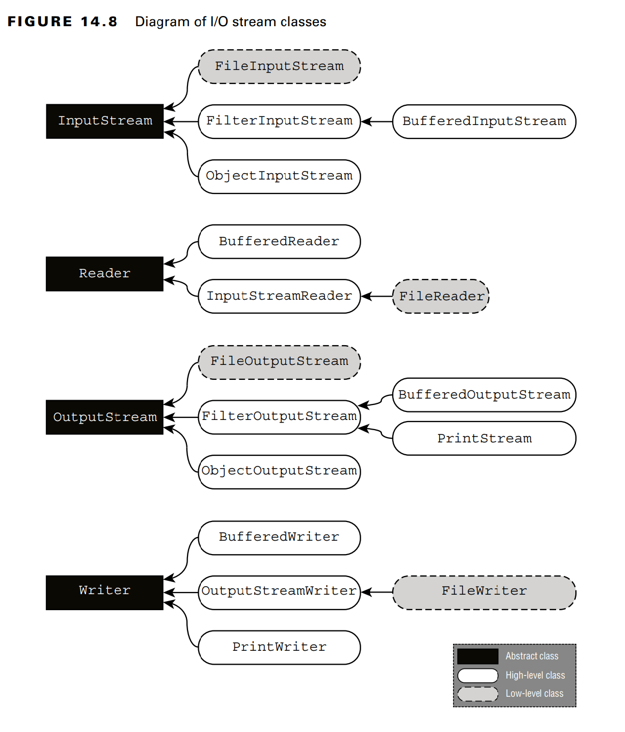
Chapter 14 - IO

Slide 77
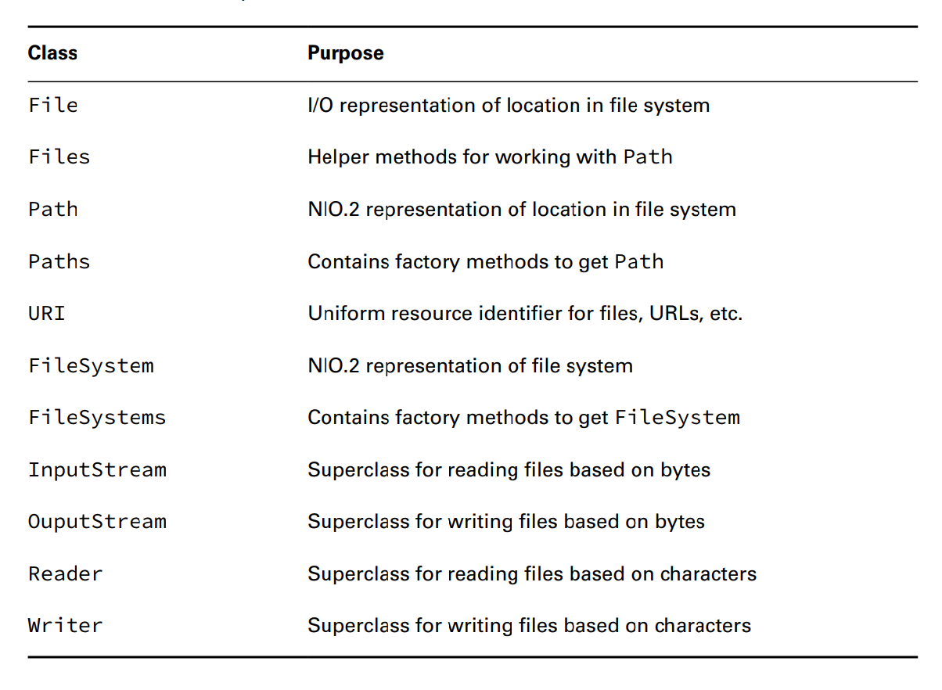
Chapter 14 - IO

Slide 78
Chapter 14 - IO
- The InputStreamReader and OutputStreamReader are extremely ... and also unique because they are the only ... that has ... and ... in the name

